Slide 1
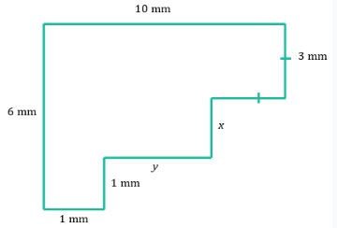
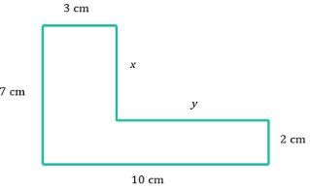
Find the value of the missing sides and calculate the perimeter of these shapes

Slide 2
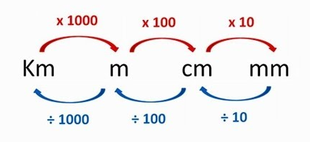
REVISION
3.64m to cm
× 100
= 364 cm
2) 1.24km to cm
x 1000 x 100
= 124 000 cm
3) 679 mm to m
÷ 10 ÷ 100
= 0.679 mm
4) 15.8 cm to mm
x 10
= 158 mm

Slide 3
24
7
30
Area
Date
EQ – How do I find the area of rectangles and triangles?

Slide 4
What is area?
on your LHS write down what you believe area to mean. Be prepared to share.
You have a piece of cardboard that is 6m long and 3m wide.
You draw lines that are 1m apart along the 6m side to make the shape into 6 columns that are 1 m wide.
Now draw lines 1m apart on the 3m side to make 3 rows that are 1m wide.
Because we are measuring how many squares are in a shape, the units are square units (eg cm², m², mm²)
You can see that there are 18 of these 1mx1m squares. Area is all about working out how many 1x1 squares can fit inside a shape.

Slide 5
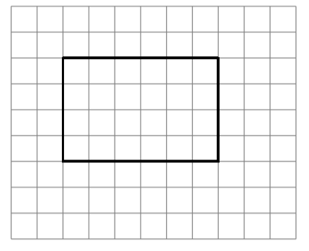
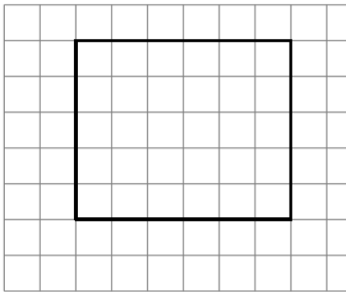
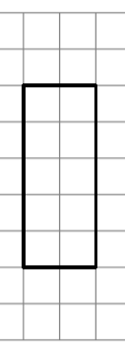
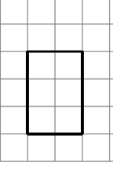
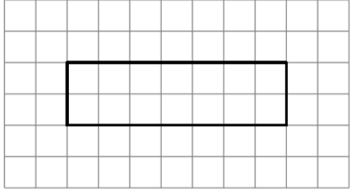
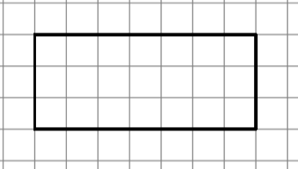
The following shapes have all been divided up already, count the area in each on your LHS.
24
30
10
6
14
21
Can you see a quicker way than counting the squares?

Slide 6
24
7
30
Area
Date
EQ – How do I find the area of rectangles and squares?
How do I find the area of rectangles
Area = Length x Width
width
length

Slide 7


24
7
30
Area
Date
EQ – How do I find the area of rectangles and triangles?
A = L x W
A = 11 x 8
A = 88
Area = Length x Width
How do I find the area of rectangles
8cm
$${cm}^{2}$$
11cm
A square is a rectangle where both length and width are the same
How do I find the area of Squares
Area = Length x Length
A = L x L
A = 6 x 6
A = 36
6cm
6cm
$${cm}^{2}$$

Slide 8
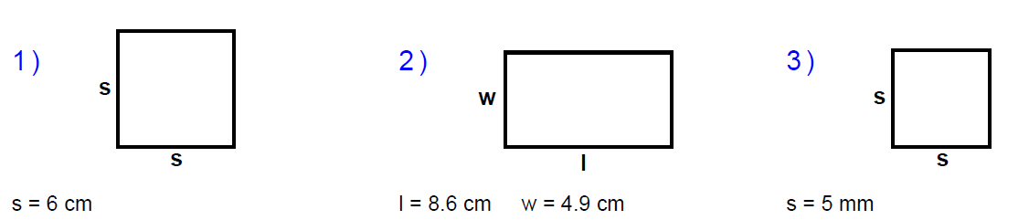
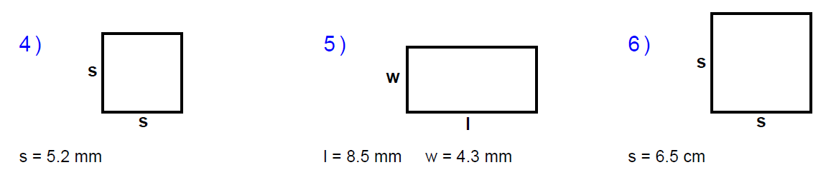
Lets try a few… Draw the diagram and show working out on your LHS for each of these

